Slide 1


Slide 2


Slide 3
2018 Beta Testing Report
Presented by:
Todd Kruse, Team 3840
Steve Moe, Team 3026
Chris Roadfeldt, Team 4607

Slide 4
Who we are?
Team 3026 uses LabView Code.
Team 3840 uses Java Code.
Team 4607 used C++ in 2016/2017.
We are all lead programming mentors for our team’s. Chris and Todd are also are CSA’s during regional and off season events.

Slide 5
What are we going to review?
What is Beta Testing?
Goals of Beta Testing.
Over View of software changes.
Installation changes.
Install order
Image tool, Radio configuration, DS changes
New Brushless motor
Code examples
Questions / Discussion

Slide 6
What Is Beta Testing?
The 2018 FIRST Robotics Competition Control System Beta Test was just completed. FIRST had 14 C++, 35 Java and 19 LabVIEW teams. MN FIRST has 5 Beta Teams.
MN Beta Teams:
2177, 2846, 3026, 3840

Slide 7
Goals of the Beta Test
Give a sizeable group of diverse teams early hands on exposure to the 2018 control system software.
Use Beta Team feedback to refine/develop supporting documentation and training materials.
Test the new features and functions of the control system to uncover problems and provide solution suggestions.

Slide 8
Goals of the Beta Test
Develop a supporting network/knowledge database about the new features.
Allow teams to become "Control System Experts" and serve as area leaders to mentor other teams.
Share information to minimize strategic advantages
Understand the difficulties and issues that Teams may encounter with the new control system features.

Slide 9
Specific Goals Include
Look for software installation problems or documentation lapses that make the process confusing.
Basic benchtop testing of the default programs.
Port prior seasons code - Optional use the 2018 software at an offseason competition.
Advanced feature testing: Network Tables stress test, camera streaming, new Java Shuffleboard dashboard testing.

Slide 10
Changes for the 2018 season control system
Driver Station
Additional Connectivity Diagnostics
DS Protocol selector for 2014 cRIO systems has been dropped.
Will NOT work on Windows XP
Notes:
2018 Driver Station

Slide 11
Changes for the 2018 season control system
General
Increase robustness of USB Camera connections and streaming
Two new robot/field simulation projects: A mechanum Maze robot simulation and a shooting/ball pickup robot simulation
Driver’s Station
New Game Data field for match information sent by FMS during match play
Notes:
2018 Driver Station

Slide 12
Changes for the 2018 season control system
Java/C++ - WPILib
New base class - TimedRobot loops on an internal timer instead of syncing to the arrival of DS packets.
More consistent timing for robot actions and controls, but potentially dropping or duping inputs.
RobotDrive class has been split into separate classes for different drive base platform types - currently includes Differential Drive (common 4wd/6wd/8wd/tank/etc. platforms), Killough Drive (3 omni's) and Mecanum
A periodic method has been added inside subsystems
Notes:
2018 Driver Station

Slide 13
Changes for the 2018 season control system
Java/C++ - WPILib
Use of SpeedController and SpeedControllerGroups are required for use with new drive classes.
Example:
std::shared_ptr<TalonSRX> RobotMap::drivetrainFrontLeft;
std::shared_ptr<TalonSRX> RobotMap::drivetrainRearLeft;
std::shared_ptr<TalonSRX> RobotMap::drivetrainFrontRight;
std::shared_ptr<TalonSRX> RobotMap::drivetrainRearRight;
std::shared_ptr<frc::DifferentialDrive> RobotMap::drivetrainRobotDrive41;
std::shared_ptr<frc::SpeedControllerGroup> RobotMap::drivetrainLeft;
std::shared_ptr<frc::SpeedControllerGroup> RobotMap::drivetrainRight;
drivetrainLeft.reset(new frc::SpeedControllerGroup(drivetrainFrontLeft->GetWPILIB_SpeedController(),drivetrainRearLeft->GetWPILIB_SpeedController()));
drivetrainRight.reset(new frc::SpeedControllerGroup(drivetrainFrontRight->GetWPILIB_SpeedController(),drivetrainRearRight->GetWPILIB_SpeedController()));
drivetrainRobotDrive41.reset(new frc::DifferentialDrive(*drivetrainLeft.get(),*drivetrainRight.get()));
Notes:
2018 Driver Station

Slide 14
Changes for the 2018 season control system
Java/C++ - Eclipse
Eclipse will update existing projects at startup. Imported projects are updated after eclipse restart.
Network Tables improved synchronization and New classes and interfaces.
Robot Code deployment done via WebDAV (replacing use of SSH)
Checks multiple address in parallel during deployment, faster deploys.
TCP based console plugin, coming soon.
Notes:
2018 Driver Station

Slide 15
Changes for the 2018 season control system
Java/C++ - CTRE
CTRE Libraries done view Lifeboat app.
CTRE object, library and header restructuring. Eg; object name: TalonSRX is now PWMTalonSRX and CANTalonSRX has been renamed to TalonSRX
roboRIO CAN software update must be applied using the 3rd party CTRE Phoenix Lifeboat application (if this isn't done, then no CAN devices, e.g., PDP, PCM, TalonSRX, will show up in the roboRIO WebDash)
Notes:
2018 Driver Station

Slide 16
Changes for the 2018 season control system
Java
Java 8 - Eclipse projects should be configured at source code compatibility to 1.8, Java 1.9 not likely to be supported for 2018 season.
RoboRio JRE – No need for manual install. JRE (zulu) deployment done automatically when deploying java code from eclipse.
Sendable Chooser now keeps entries ordered.
Notes:
2018 Driver Station

Slide 17
Changes for the 2018 season control system
CTRE::MotorControl::CAN
C++
Restructure of CTRE libraries and headers. Eg;
#include <CANTalon.h> is now
#include "ctre/phoenix/MotorControl/CAN/TalonSRX.h“
CTRE has put all their classes inside namespaces
Eg; TalonSRX is now in the namespace CTRE::MotorControl::CAN
CTRE will be adding a master include Phoenix.h which will include all CTRE includes. One stop shop for CTRE headers.
Notes:
2018 Driver Station

Slide 18
Changes for the 2018 season control system
CTRE::MotorControl::CAN
Network Tables
Improved Connection Synchronization Behavior
Reduction or elimination of phantom keys.
Client / Server data sync optimization.
Client changed data is push to server.
Client unchanged data is either removed or pushed from server.
JSON is a valid data structure via NetworkTables
Improved performance
Java callbacks handled by java thread vs native thread
Notes:
2018 Driver Station

Slide 19
Changes for the 2018 season control system
CTRE::MotorControl::CAN
Misc.
Smartdashboard
Shuffleboard dashboard added. – See notes, eg. The future?
SFK dashboard is gone.
Outline Viewer
Rewritten in JavaFX
Checkboxes for Booleans.
Notes:
2018 Driver Station

Slide 20
Software Order of Installation
Install the programming language of your choice: Basic LabVIEW 2017 or Java/C++
FRC Update
You get a message if the Microsoft .NET Framework 3.5 needs to be installed separately
CTRE Installer-obtained separately
Reimage roboRIO (operating system)
Other 3rd Party installations, e.g., NAVX
Compile and Download User Code

Slide 21

roboRIO Imaging Tool
Make sure the PC has been restarted after the installation of the FRC Update, otherwise you'll get an error message from trying to run this tool.
A desktop shortcut to the roboRIO Imaging Tool has been added, so it's much easier to find and use.
Notes:
No need to down load JRE on roboRIO afters Eclipse Plug in takes care of this now.

Slide 22
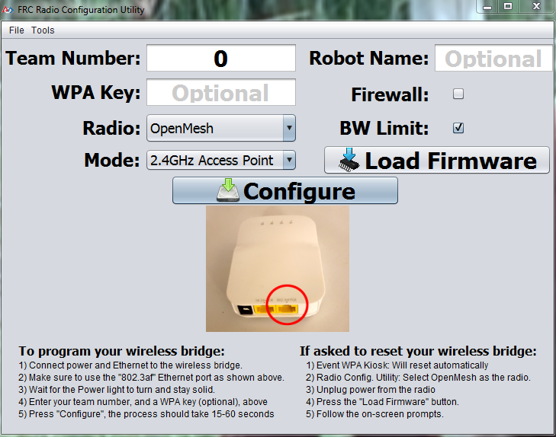
Radio Configuration
DHCP Server now has static reservation for roboRIO (by hostname) of 10.TE.AM.2. This should ensure the roboRIO is always assigned this address if connected to the radio, providing additional robustness to DS detection.
Secondary Ethernet port issue on OM5P-AC believed to be resolved
DHCP Server will now remain enabled on the wired interface when configured as a bridge, mimicking the proposed behaviour of the field.
Combined with the static reservation above, this will allow teams laptops to connect to the roboRIO when tethering through the radio in any combination of static/DHCP on either device as long as the static is set for the correct team without needing self-assigned IPs. If tethering directly to the roboRIO both devices will still need to match (either both static or both DHCP).
Notes:
Chris will give his speech about the radio’s We believe both radios will still work 2016 and 2017 but still tune.

Slide 23
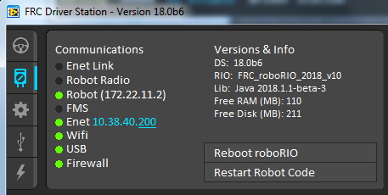
New Driver Station Connectivity Diagnostics
Enet Link - active Ethernet port
Robot Radio - answers ping at team address 10.TE.AM.1
Robot (ip address) - answers ping at the ip address. ip can be 10.TE.AM.2, 10.TE.AM.xx, 169.254.xx.xx
FMS - talking to the Field Management System (official field only)

Slide 24
New Driver Station Connectivity Diagnostics
Enet (ip address) - PC Ethernet active ip (not necessarily the robot)
Wifi - PC wireless is actively connected to wifi network (robot radio or school/home/venue AP)
USB - PC tethered to roboRIO via USB (172.22.11.2)
Firewall (Dom,Pub,Pr) - lit green means all three parts of the Windows firewall are disabled. (Dom,Pub,Pr) identifies which parts are still active: Domain, Public, and/or Private

Slide 25
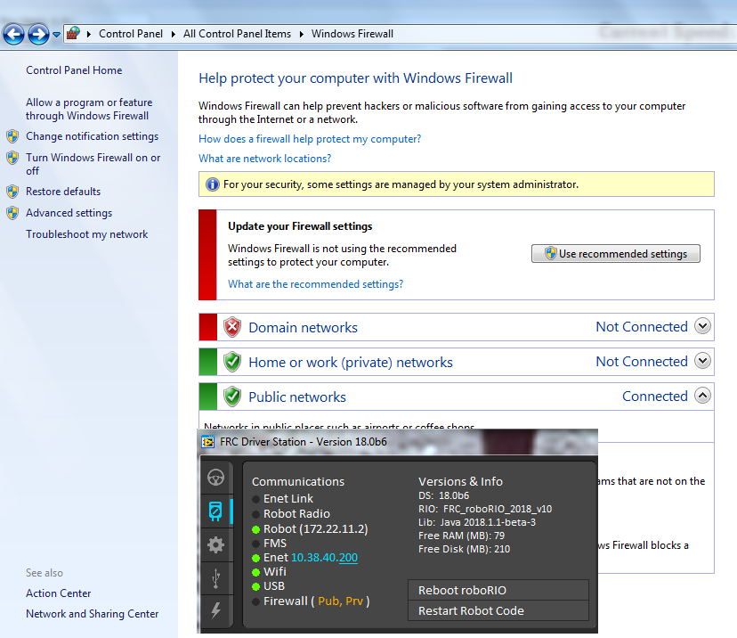
New Driver Station Connectivity Diagnostics

Slide 26
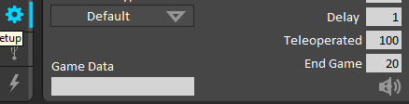
New Driver Station Game Data
A new Game Data field can be found on the Driver Station Setup tab. It is a field that will be populated with match specific information (TBD based on the game to come) during official matches.
Notes:
The FRC LabVIEW Dashboard is the default dashboard program installed with, and automatically launched by, the FRC Driver Station. The purpose of the Dashboard is to provide feedback about the operation of the robot. The FRC Default Dashboard serves as a an example of the types of feedback
teams may want from their robot.

Slide 27
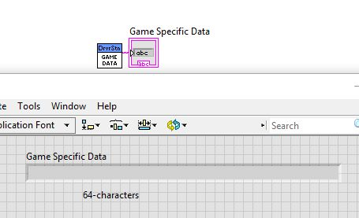
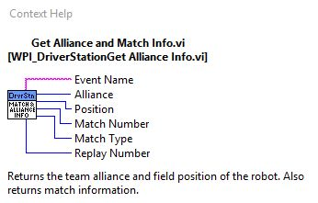
Driver Station - Game Data
Additional information is available during a match:

Slide 28
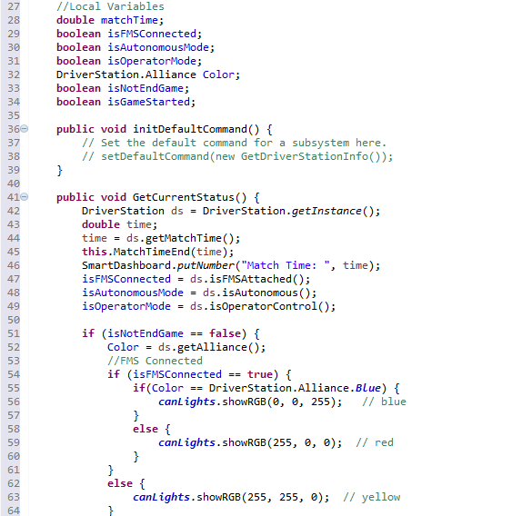
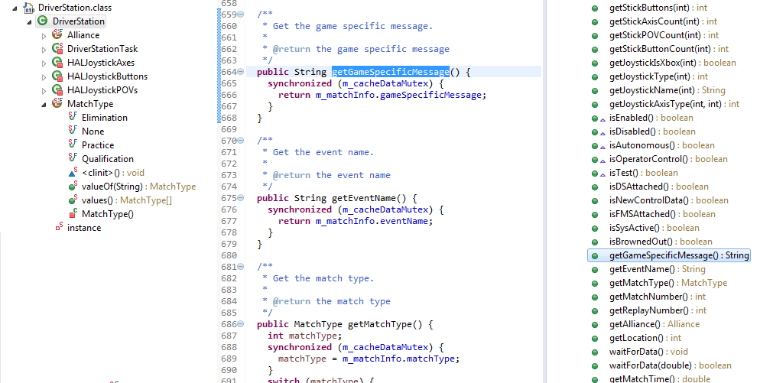
Driver Station - Game Data
Additional information is available during a match:
Notes:
Located in the package edu.wpi.first.wpilibj.
import edu.wpi.first.wpilibj.DriverStation;
This provides all the get function calls for information off the driver station data packets.

Slide 29
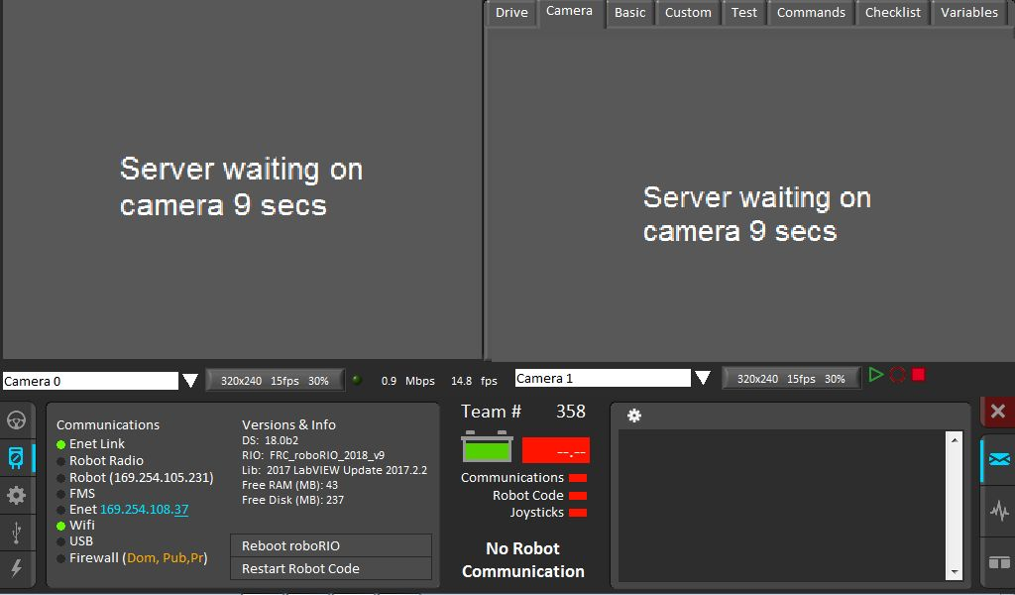
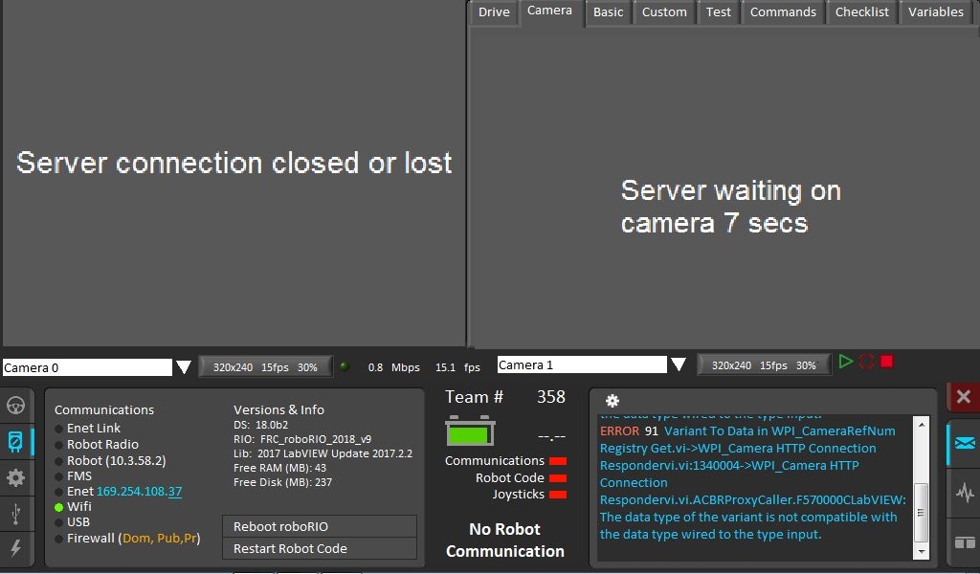
New LabVIEW USB Camera Handling
The USB camera stream handling is more robust and does more to recover from camera and roboRIO disconnects. Here is a sequence of screenshots demonstrating the recovery process after communications with the roboRIO were dropped (The Ethernet connection was physically disconnected/reconnected) disconnected/reconnected).
Notes:
The FRC LabVIEW Dashboard is the default dashboard program installed with, and automatically launched by, the FRC Driver Station. The purpose of the Dashboard is to provide feedback about the operation of the robot. The FRC Default Dashboard serves as a an example of the types of feedback
teams may want from their robot.

Slide 30
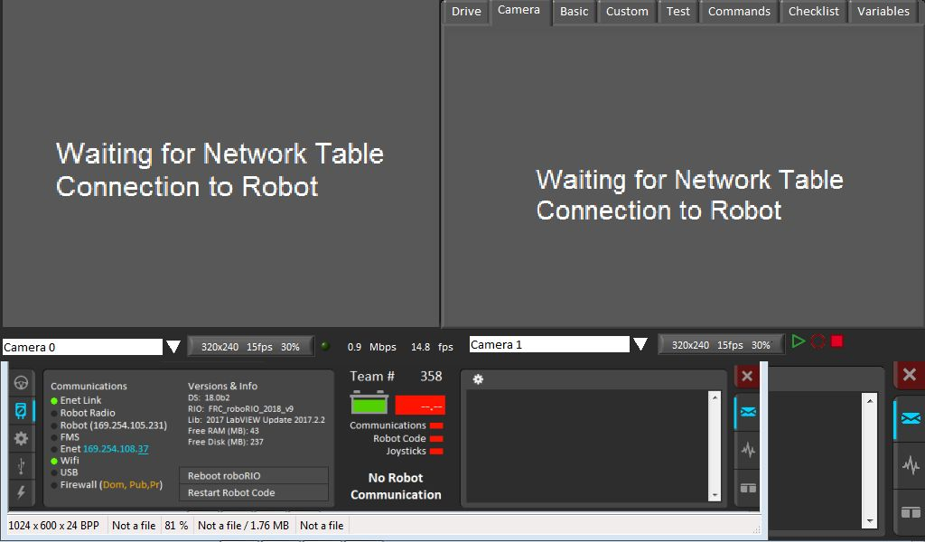
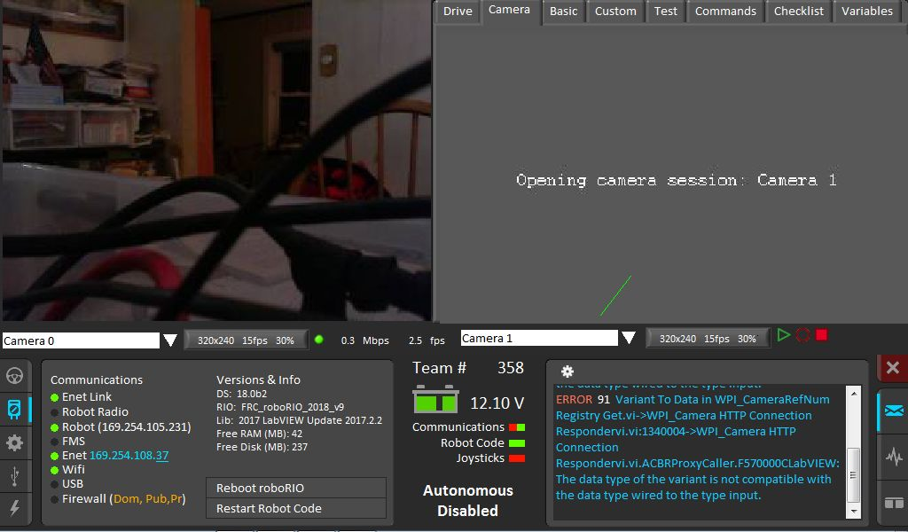
New LabVIEW USB Camera Handling
Notes:
The FRC LabVIEW Dashboard is the default dashboard program installed with, and automatically launched by, the FRC Driver Station. The purpose of the Dashboard is to provide feedback about the operation of the robot. The FRC Default Dashboard serves as a an example of the types of feedback
teams may want from their robot.

Slide 31
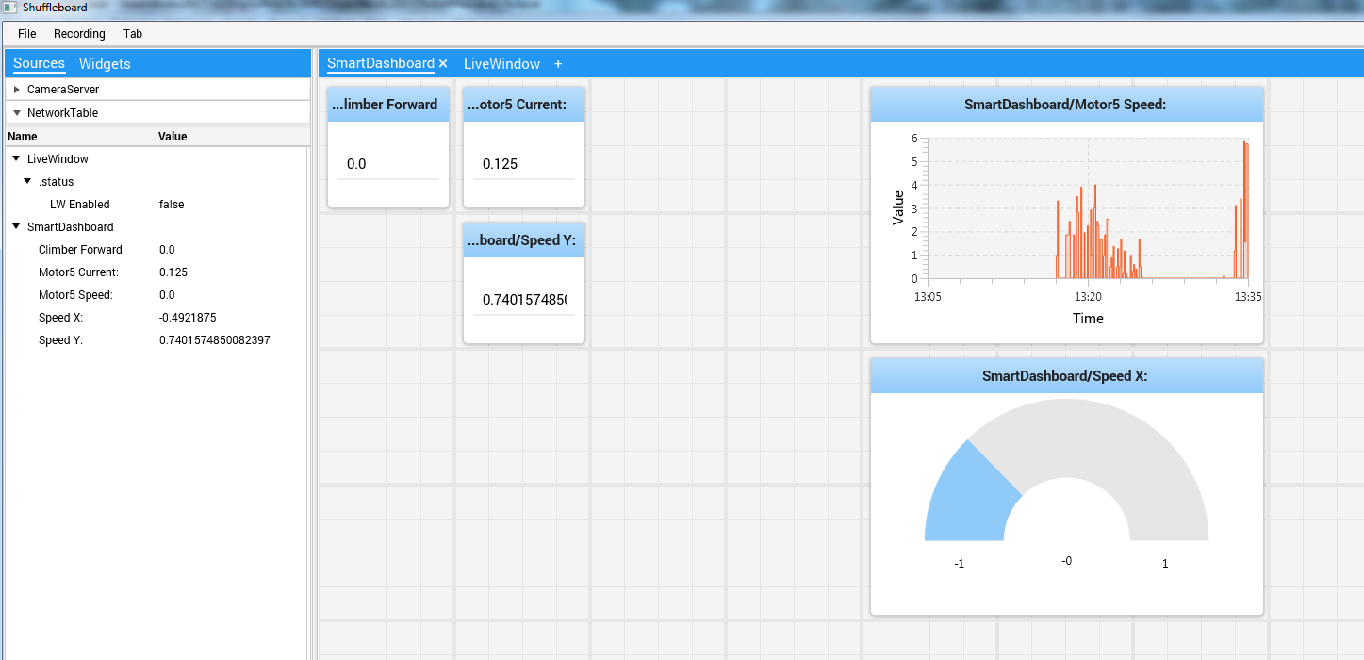
Driver Station – Shuffleboard
Notes:
The Shuffleboard is an alternate dashboard application written in Java. The Shuffleboard
automatically creates a widget for each variable sent from the Robot sent using the SmartDashboard
class or VIs. These widgets can be configured to a number of preset display types, or users can create
custom extensions in Java. FIRST is going make going to make this selectable on the by type instead of programming laungue .

Slide 32
Driver Station – Shuffleboard
INSERT JAVA/C++ EXAMPLE
Live Demo insert here.
Notes:
The SmartDashboard is an alternate dashboard application written in Java. The SmartDashboard
automatically creates a widget for each variable sent from the Robot sent using the SmartDashboard
class or VIs. These widgets can be configured to a number of preset display types, or users can create
custom extensions in Java.

Slide 33
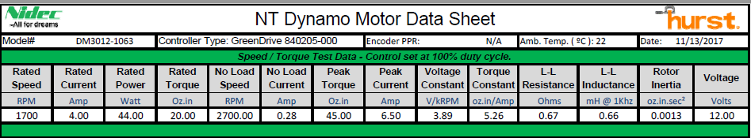
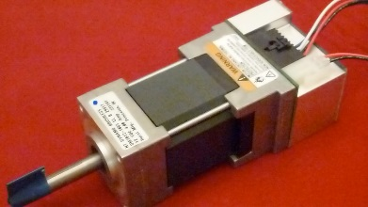
Nidec Dynamo BLDC Motor with Controller

Slide 34
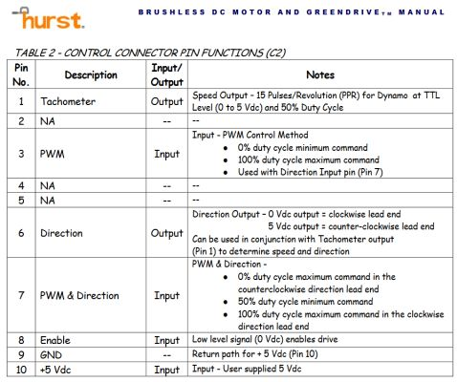
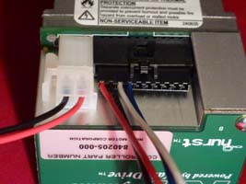
Nidec Dynamo BLDC Motor with Controller

Slide 35
Nidec Dynamo BLDC Motor with Controller
Wiring Connections: A red/white connector goes to a PWM output (red=signal, white=ground) This is only used as a signal to Enable/Disable the motor with the robot.
A black/blue connector goes to a DIO (blue=signal,black=ground) This produces a PWM signal to control the direction and speed of the motor.
Bare Red/white wires connect to the PDP (20a breaker) and provide the power.

Slide 36
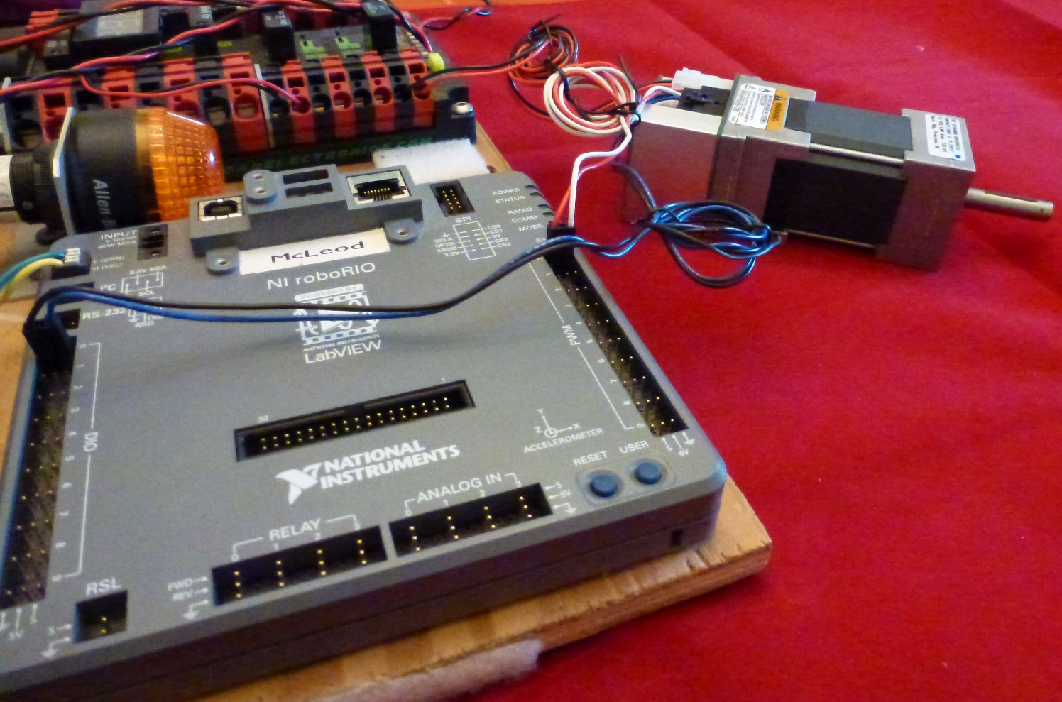
Nidec Dynamo BLDC Motor with Controller

Slide 37
Nidec Dynamo BLDC Motor with Controller
Hookups to the roboRIO/PDP:
There is a caution with the brushless wiring. **** If the DIO connection comes loose, then the motor will race uncontrollably while the robot is Enabled. ****
It is designed to be disabled when the robot is disabled, so it can be quickly halted if this happens. But remember that if it happens during a match, then the only way to Disable the runaway motor is by eStop and your role in the match is over.

Slide 38
Nidec Dynamo BLDC Motor with Controller
Consider your application carefully to account for this possibility. A racing beater bar isn't a problem, but a racing gripper might burn out the motor or damage the mechanism.
You can program in a safety override to disable the motor with a button, or to automatically disable the motor if it isn't being sent a power command.

Slide 39
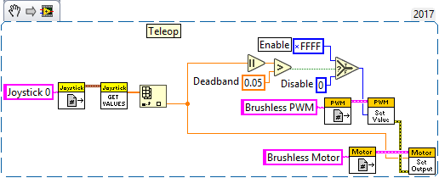
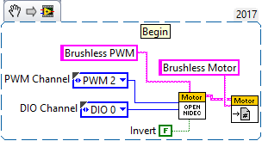
Nidec Dynamo BLDC Motor with Controller LabView Example
Here is one suggested approach that keeps the Nidec motor Disabled unless actively being driven. This can be reduced to a user version of the LV Motor Open and Motor Set Output that hides all this implementation and lets the programmer treat it just as any other motor:

Slide 40
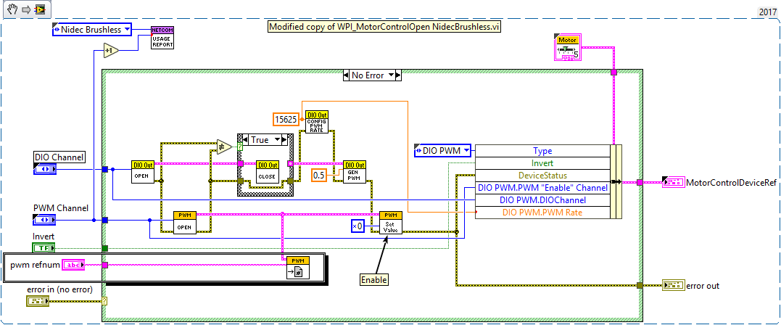
Nidec Dynamo BLDC Motor with Controller LabView Example
Make a copy of WPI_MotorControlOpen NidecBrushless.vi This can be done by dropping a Motor Open in a block diagram, switching it to Nidec Brushless, then saving the vi.

Slide 41
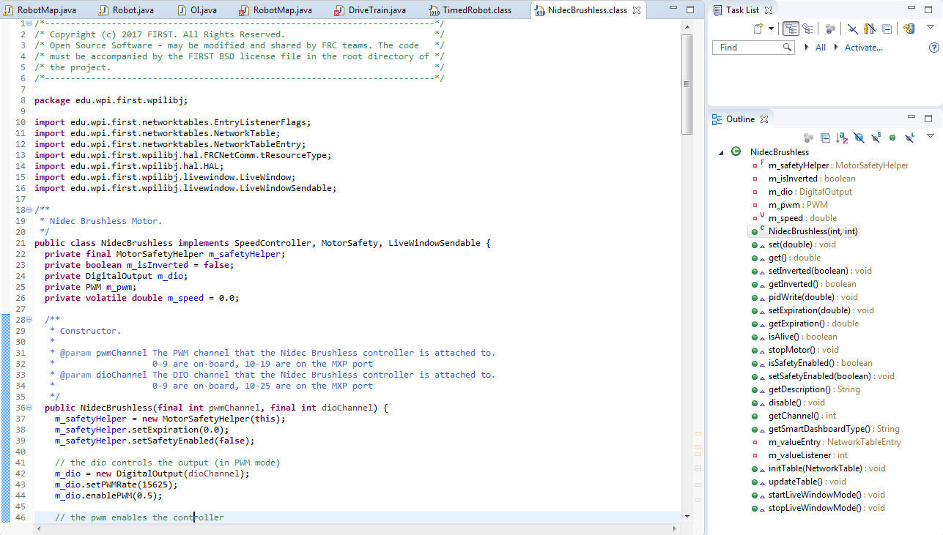
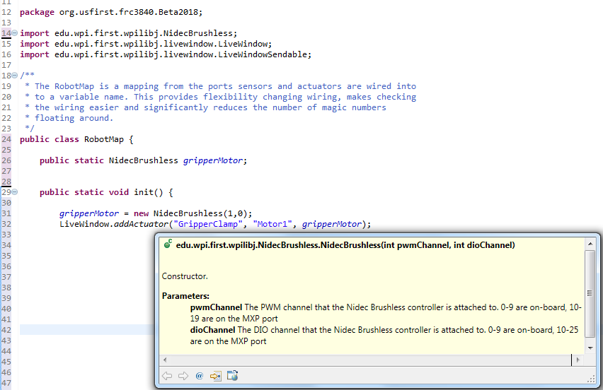
Nidec Dynamo BLDC Motor with Controller Java Example
Notes:
Located in the package edu.wpi.first.wpilibj.
import edu.wpi.first.wpilibj.NidecBrushless;

Slide 42
Resources
Installing the FRC 2018 Update Suite
http://wpilib.screenstepslive.com/s/currentCS/m/getting_started/l/599670-installing-the-frc-2018-update-suite-all-languages
Getting Started with the 2018 Control System
https://wpilib.screenstepslive.com/s/4485/m/13503
Configuring an Axis Camera
https://wpilib.screenstepslive.com/s/4485/m/24194/l/144985-configuring-an-axis-camera?id=144985-configuring-an-axis-camera
FRC Driver Station Powered by NI LabVIEW
http://wpilib.screenstepslive.com/s/4485/m/24192/l/144976?data-resolve-url=true&data-manual-id=24192

Slide 43
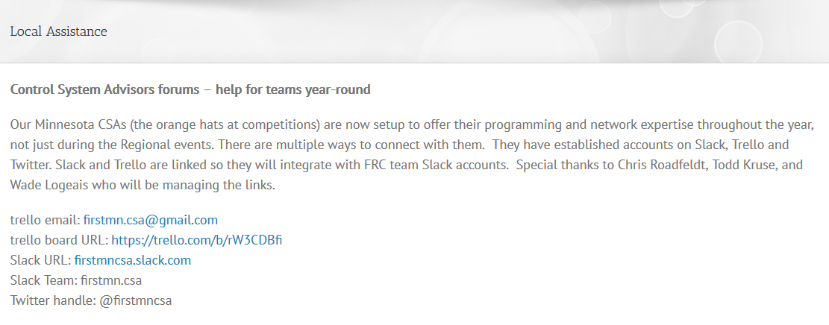
Questions / Comments

